Slide 1


EMMANUEL ONAH
10 March 2023

Slide 2

Outline
Executive Summary
Introduction
Methodology
Results
Conclusion
Appendix

Slide 3
Executive Summary
Summary of methodologies:
Dataset used for the project was collected via several ways such as web scrapping from Wikipedia page and SpaceX API calls.
Data wrangling was performed followed by exploratory data analysis and feature selection, engineering and standardization and one-hot encoding.
Several interactive visualization were done to communicate the findings.
Classification machine learning models were built to predict the landing success of the SpaceX rocket.
Summary of all results:
All the models - logistic regression, decision tree, k-nearest neighbor, and support vector machine exhibited high predictive accuracy of greater than 83%. However, decision tree had the highest predictive accuracy of over 88%.
Factors such as launch site, payload mass, and orbit contribute significantly to the successful landing of a Falcon 9 rocket.

Slide 4
Introduction
Project background and context
SpaceX is an American spacecraft manufacturer, launcher, and satellite communications company. Elon Musk founded it in 2002 with the stated goal of lowering space transportation costs to enable Mars colonization. The Falcon 9, Falcon Heavy, and Starship launch vehicles, as well as several rocket engines, Cargo Dragon and Crew Dragon spacecraft, and Starlink communications satellites, are all manufactured by the company. SpaceX has accomplished a number of feats in space exploration. On its website, SpaceX promotes Falcon 9 rocket launches for 62 million dollars; other suppliers charge upwards of 165 million dollars for each launch. A large portion of the savings is due to SpaceX's ability to reuse the first stage.
Hence, in this project, we aim to figure out if the first stage will land, we can figure out how much a launch will cost. If a different business want to compete with SpaceX for a rocket launch, it may use the information provided here.
Problems you want to find answers
Predicting whether the Falcon 9 first stage will land successfully is the main problem this project is aimed at answering.
Other problems whose answer will ultimately lead to the above goal include:
What are the factors affecting the successful landing of a Falcon 9 rocket?
What is the accuracy of a successful landing of Falcon 9?
How does the site of launch, the payload mass, orbit, etc. affect the successful landing of falcon 9?

Slide 5

Section 1

Slide 6
Methodology
Executive Summary
Data collection methodology:
Request to the SpaceX API
Web scraping Falcon 9 and Falcon Heavy Launches Records from Wikipedia
Perform data wrangling:
Missing values were filled up and appropriate type conversion perfumed
Data were standardized and one-hot encoded to be used later as input for the machine learning model
Perform exploratory data analysis (EDA) using visualization and SQL
Discovering new patterns in the data using various visualizations such as scatter plot
Perform interactive visual analytics using Folium and Plotly-Dash
Dash and Folium were used to create interactive plots
Perform predictive analysis using classification models:
Logistic regression, Decision tree, K-nearest neighbor, and support vector machine were trained on 80% of the dataset after hyper-parameter tuning and the remaining 20% was used for testing of the models

Slide 7
Data Collection
The dataset used for this project was collected from two major sources –
By making request to the SpaceX API endpoint (https://api.spacexdata.com/v4/) and
By Web scraping Falcon 9 and Falcon Heavy Launches Records from Wikipedia (https://en.wikipedia.org/w/index.php?title=List_of_Falcon_9_and_Falcon_Heavy_launches&oldid=1027686922).
The flowchart below shows the data collection process:
SpaceX API calls
Data Cleaning
Saving Data to CSV file
Raw Datasets
Web Scrapping Wikipedia

Slide 8
Data Collection – SpaceX API
The “get method” of the request library was used to make the SpaceX REST calls to the API endpoint.
The link to the GitHub repo where the completed SpaceX API calls notebook was hosted is given below: https://github.com/OnahPmi/My_Coursera_Repo/blob/77b67417658e9ae94a8396e402942ed25b494e39/Applied%20Data%20Science%20Capstone%20Project/SpaceX_Falcon_9_First_Stage_Landing_Prediction_(SpaceX_API_calls).ipynb
1. Collecting data with SpaceX API calls
2. Converting data to pandas dataframe
4. Filtering the data to keep only Falcon 9 launches
3. Preprocessing of data
5. Saving the dataframe to a CSV file

Slide 9
Data Collection - Scraping
The BeautifulSoup python library was used to scrap the Wikipedia site for Falcon 9 and Falcon Heavy Launches Records.
The link to the GitHub repo where the completed web scraping notebook was hosted is given below: https://github.com/OnahPmi/My_Coursera_Repo/blob/aabcfb02e258a6ea82529b526d8daf1ee69238e4/Applied%20Data%20Science%20Capstone%20Project/SpaceX_Falcon_9_First_Stage_Landing_Prediction_(Web_scrapping_records_from_Wikipedia).ipynb
1. Creating the BeautifulSoup Object
2. Getting the column names
4. Converting to pandas dataframe
3. Creating the launch dictionary
5. Saving the dataframe to a CSV file

Slide 10
Data Wrangling
The dataset was processed as follows:
Missing values were replaced with the mean value of the column.
Appropriate type conversion were done.
Number of launch on each site was calculated.
Number and occurrence of each orbit was calculated.
Number and occurrence of mission outcome per orbit type was calculated
Outcome labels (“1” for Successful outcome and “0” for bad outcome) was created.
The link to the GitHub repo where the completed data wrangling related notebooks was hosted is given below: https://github.com/OnahPmi/My_Coursera_Repo/blob/ef7c6a854321fbf6a7eed4ff28369606a05425ba/Applied%20Data%20Science%20Capstone%20Project/SpaceX_Falcon_9_First_Stage_Landing_Prediction_(Data_wrangling).ipynb
1. Loading the dataset
2. Handling missing values and type conversion
3. Calculating number of launch on each site
4. Calculating number and occurrence of each orbit
6. Labelling the outcomes as 1 for successful landing and 0 for failure
5. Calculate the mission outcome per orbit
7. Saving the dataset to a CSV file

Slide 11
EDA with Data Visualization
“Categorical”, “scatter” and “line” plots were generated to find some pertains in the data. Pandas, Seaborn, and Matplotlib were used for the exploratory data analysis (EDA).
The link to the GitHub repo where the completed exploratory data analysis, data preparation and feature engineering notebook was hosted is given below: https://github.com/OnahPmi/My_Coursera_Repo/blob/9eeb98da70a2ab44a5baec1d50423dc9c586f7a4/Applied%20Data%20Science%20Capstone%20Project/SpaceX_Falcon_9_First_Stage_Landing_Prediction_(Exploring_and_Preparing_Data).ipynb

Slide 12
EDA with SQL
The following are the SQL queries performed:
Display the names of the unique launch sites in the space mission
Display 5 records where launch sites begin with the string 'CCA‘
Display the total payload mass carried by boosters launched by NASA (CRS)
Display average payload mass carried by booster version F9 v1.1
List the date when the first successful landing outcome in ground pad was achieved.
List the names of the boosters which have success in drone ship and have payload mass greater than 4000 but less than 6000
List the total number of successful and failure mission outcomes
List the names of the booster_versions which have carried the maximum payload mass. Use a subquery
List the records which will display the month names, failure landing_outcomes in drone ship ,booster versions, launch_site for the months in year 2015.
Rank the count of successful landing_outcomes between the date 04-06-2010 and 20-03-2017 in descending order.
The link to the GitHub repo where the completed EDA with SQL notebook was hosted is given below: https://github.com/OnahPmi/My_Coursera_Repo/blob/60211f6d993e7db099662ff88fac650ce5e0f269/Applied%20Data%20Science%20Capstone%20Project/SpaceX_Falcon_9_First_Stage_Landing_Prediction_(EDA_with_SQL).ipynb

Slide 13
Build an Interactive Map with Folium
The map objects created and added to a folium map include:
folium.Marker(): to create marks on the map.
MarkerCluster(): to simplify a map which contain several markers with identical coordinates.
MousePosition(): to display coordinate of a point as you mouse over the map.
folium.Circle(): to add a highlighted circle area with a text label on a specific coordinate.
Folium.PolyLine(): to create polynomial lines between points on the map.
The link to the GitHub repo where the completed interactive map with Folium map notebook was hosted is given below: https://github.com/OnahPmi/My_Coursera_Repo/blob/c3a2dc4390c98a851416e9b741b0fdd23f3890f0/Applied%20Data%20Science%20Capstone%20Project/Launch_Sites_Locations_Analysis_with_Folium.ipynb

Slide 14
Build a Dashboard with Plotly Dash
The following were used to build the dashboard with plotly dash:
Dash HTML components and callbacks: Important components of a dash application. Everything such as graphs, rangeslider and dropdown, etc. depend on them.
Pandas was used to load dataset into a dataframe and also for processing the data before plotting.
Plotly was used to plot the graphs --- pie charts and scatter plots
Rangeslider was used for selecting payload mass range.
Dropdown was used for launch site selection.
The link to the GitHub repo where the completed Plotly Dash lab notebook was hosted is given below: https://github.com/OnahPmi/My_Coursera_Repo/blob/ed94597f3d4d9f83fc8f1b063bbd4307a8bd585a/Applied%20Data%20Science%20Capstone%20Project/spacex_dash_app.py

Slide 15
Predictive Analysis (Classification)
Summary of how the models were built, evaluated, improved, and the best performing classification model selected:
The link to the GitHub repo where the completed predictive analysis lab notebook was hosted is given below: https://github.com/OnahPmi/My_Coursera_Repo/blob/4bd192bd158670e6a0128426319c2331f944f36d/Applied%20Data%20Science%20Capstone%20Project/SpaceX_Falcon_9_First_Stage_Landing_Prediction_(Machine_Learning_Prediction).ipynb
1. Data collection and cleaning
2. Feature engineering and one-hot encoding
3. Data splitting (Training, validation and testing)
6. Selection of best performing model
5. Model training and evaluation
4. Hyper-parameter tuning and models’ improvement

Slide 16
Results
Exploratory data analysis results
Interactive analytics demo in screenshots
Predictive analysis results

Slide 17

Section 2

Slide 18
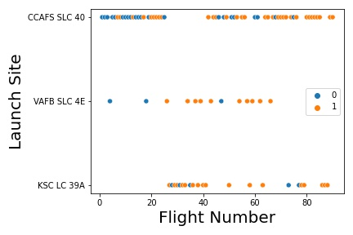
Flight Number vs. Launch Site
Scatter Plot of Flight Number vs. Launch Site
1 represent successful landing, while 0 represent landing failure.
Among all the Launch Sites, the landing success rate are higher as the Flight Number increases.
Launch site CCAFS SLC 40 had the largest number of launches based on Flight Number with 33 successes and 22 failures.
Launch site VAFB SLC 4E had the least number of launches based on Flight Number with 10 successes and 3 failures.
Launch site KSC LC 39A had the second largest number of launches based on Flight Number with 17 successes and 5 failures.

Slide 19
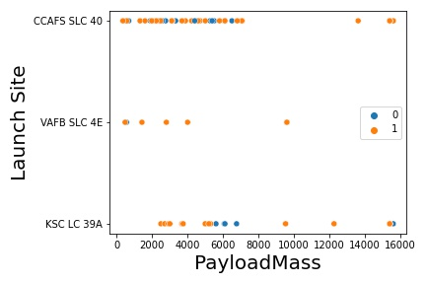
Payload vs. Launch Site
Scatter plot of Payload vs. Launch Site
1 represent successful landing, while 0 represent landing failure.
Among all the Launch Sites, the landing success rate are higher for lower payload masses.
For launch site, KSC LC 39A, the highest failure occurred for payload mass between 4000 and 8000 Kg.
Launch Site CCAFS SLC 40 has the highest numbers of launches followed by KSC LC 39A and VAFB SLC 4E.

Slide 20
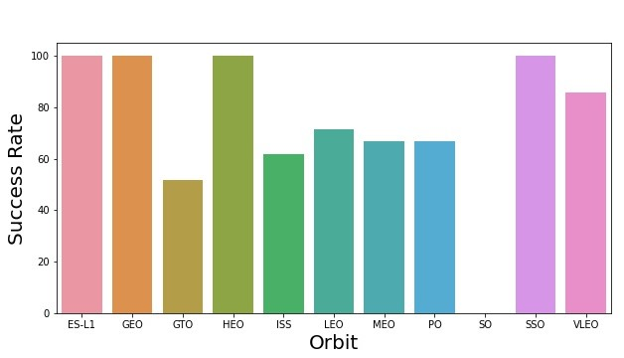
Success Rate vs. Orbit Type
Bar chart for the success rate of each orbit type
Rockets with Orbit types of ES-L1, GEO, HEO, and SSO have 100 % landing success rate.
Rockets with Orbit type of VLEO have success rate greater than 80 %.
Rochets with Orbit types of ISS, LEO, MEO, and PO have landing success rate above 60 %.
Rockets with orbit type of GTO have landing success rate greater than 50 %.
Rockets with Orbit type SO have 0 % landing success rate.

Slide 21
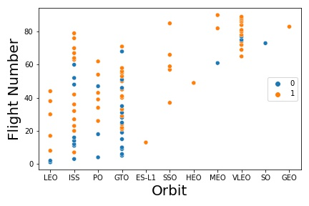
Flight Number vs. Orbit Type
Scatter point of Flight number vs. Orbit type
1 represent successful landing, while 0 represent landing failure.
Generally, it appears that the higher the Flight number of each orbit type, the higher the landing success.

Slide 22
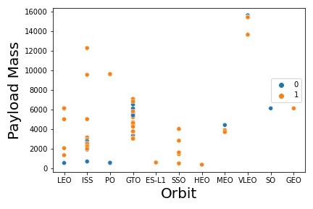
Payload vs. Orbit Type
scatter point of payload vs. orbit type
1 represent successful landing, while 0 represent landing failure.
Besides Rockets with Orbit types of GTO, MEO, VLEO and SO, landing success appears to increase with increase in payload mass.
Rockets with Orbit types ES-L1, SSO, HEO, and GEO have 100 % landing success.
Overall, there has been more successful landing than failure.

Slide 23
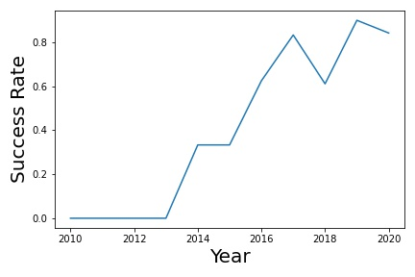
Launch Success Yearly Trend
Line chart of yearly average success rate
The net success rate since 2013 kept increasing till 2020.
The success rate between 2010 and 2013 remained at a constant rate of 0 %.
There was a fall in the success rate between 2017 and 2018 followed by a subsequent rise in the succeeding years.
Between 2014 and 2015, the success rate plateaued at a value of about 0.38 (38 %).

Slide 24
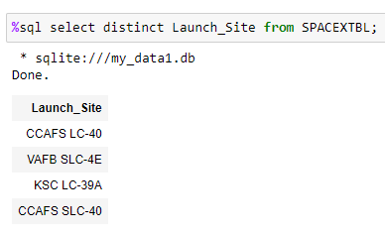
All Launch Site Names
Names of the unique launch sites
To select unique launch sites, DISTINCT is used in the SELECT statement

Slide 25
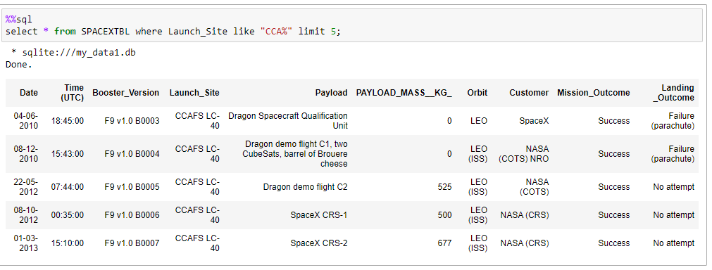
Launch Site Names Begin with 'CCA'
5 records where launch sites begin with `CCA`
Use LIKE and the “%” wildcard in the WHERE clause and limit the result to 5.

Slide 26
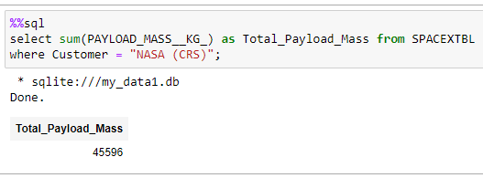
Total Payload Mass
The total payload carried by boosters from NASA
Use SUM() function and set Customer to “NASA (CRS)” in the WHERE clause

Slide 27
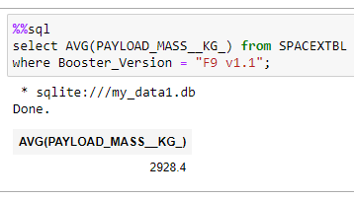
Average Payload Mass by F9 v1.1
The average payload mass carried by booster version F9 v1.
Use the AVG() function and set Booster_Version to “v1.1” in the WHERE clause.

Slide 28
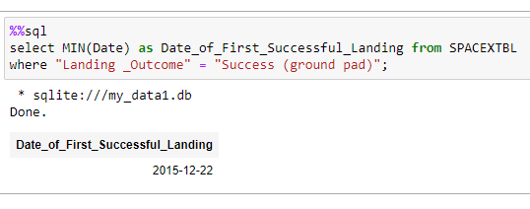
First Successful Ground Landing Date
Find the date of the first successful landing outcome on ground pad
Since “first date” means the “minimum date” we use the MIN() function and set Landing outcome to “Success (ground pad)” in the WHERE clause

Slide 29
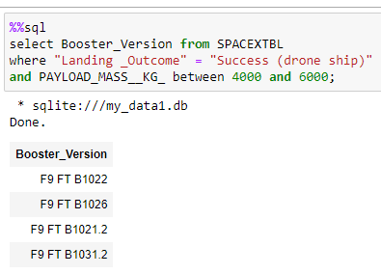
Successful Drone Ship Landing with Payload between 4000 and 6000
Names of boosters which have successfully landed on drone ship and had payload mass greater than 4000 but less than 6000
Set Landing Outcome to “Success (drone ship) and use ”BETWEEN to filter the payload mass in the WHERE clause

Slide 30
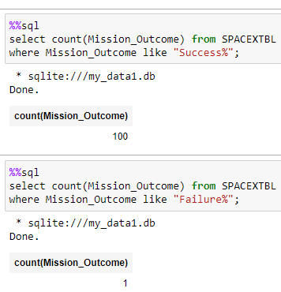
Total Number of Successful and Failure Mission Outcomes
The total number of successful and failure mission outcomes
For successful mission outcome, use like and wildcard in the WHERE clause to filter out mission outcome with Success.
For successful mission outcome, use like and wildcard in the WHERE clause to filter out mission outcome with Failure.

Slide 31
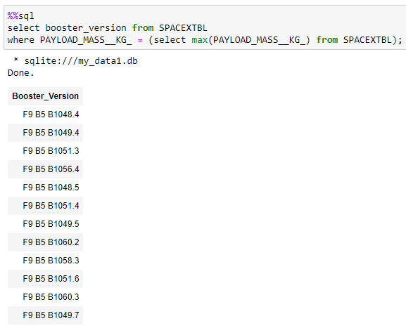
Boosters Carried Maximum Payload
Names of the booster which have carried the maximum payload mass
Use the MAX() function in the subquery to filter out the booster versions with the maximum payload mass

Slide 32
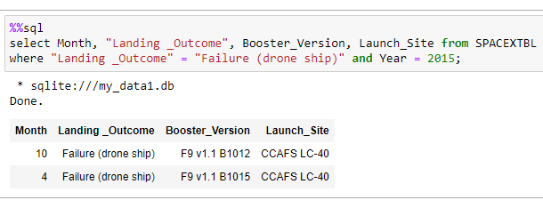
2015 Launch Records
The failed landing_outcomes in drone ship, their booster versions, and launch site names for in year 2015
Use the WHERE clause to filter out the desired results.

Slide 33
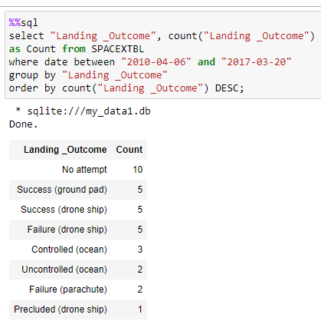
Rank Landing Outcomes Between 2010-06-04 and 2017-03-20
Rank the count of landing outcomes (such as Failure (drone ship) or Success (ground pad)) between the date 2010-06-04 and 2017-03-20, in descending order
Use GROUP BY and ORDER BY (in descending order) to filter the “landing outcome” and “count of the landing outcome” in the WHERE clause.

Slide 34

Section 3

Slide 35
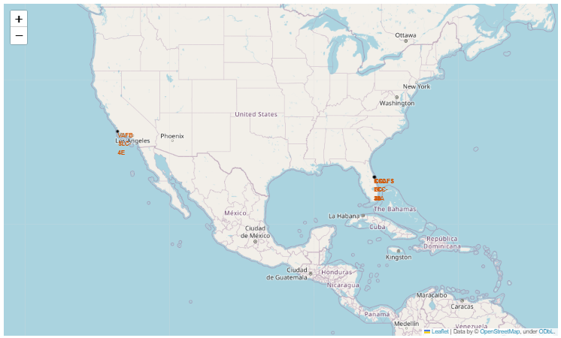
All launch sites’ location markers on a global map
All the launch sites are located close to coastlines.
Launch site VAFB SLC-4E is located close to the Vandenberg State Marine Reserve.
Launch sites CCAFS SLC-40, CCAFS LC-40 and KSC LC-39A are close to each other and in close proximity to Merritt Island National Wildlife Refuge.

Slide 36
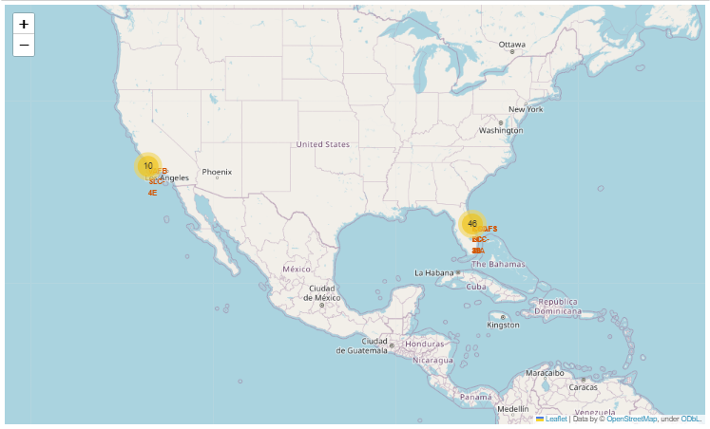
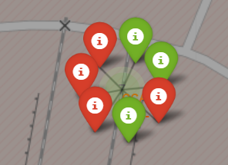
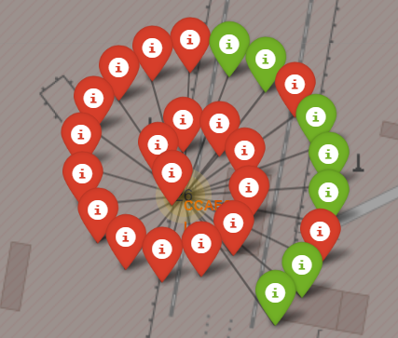
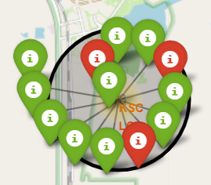
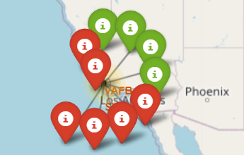


Color-labeled launch outcome from each site location on a global map
CCAFS SLC-40
CCAFS LC-40
The red markers show launch sites with failure while the green markers show launch sites with success. KSC LC-39A has the highest success rate.
KSC LC-39A
VAFB SLC-4E

Slide 37
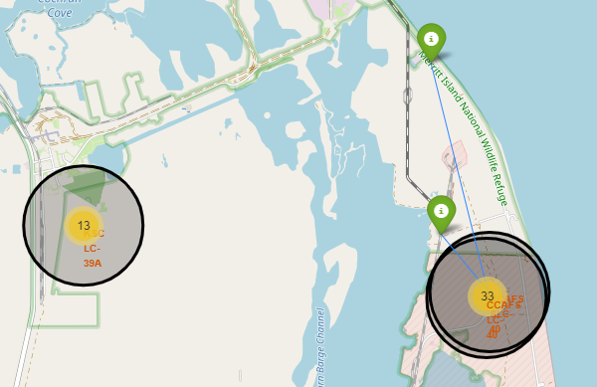
Selected launch sites and there proximities to railways, highways, coastlines, with distance calculated and displayed
Launch sites are in close proximity to railways, highways, and coastlines but keep certain distance away from cities.

Slide 38

Section 4

Slide 39
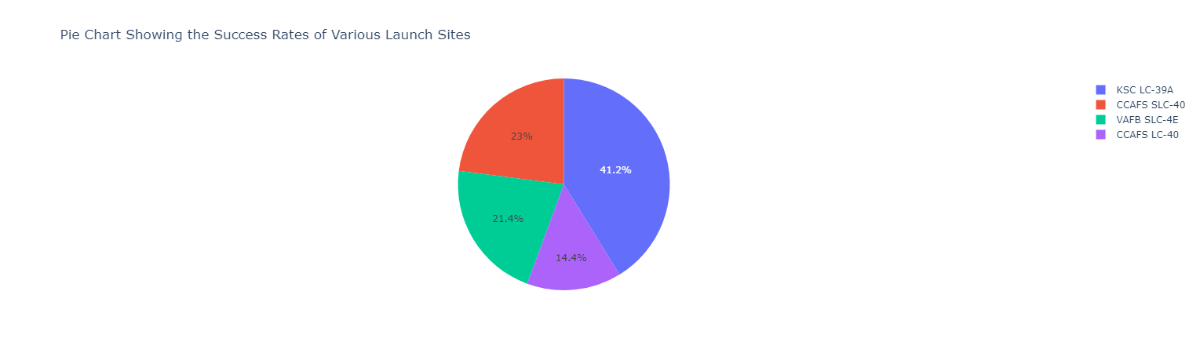
Launch success count for all sites
KSC LC-39A has the highest success rate followed by CCAFS SLC-40, VAFB SLC-4E and CCAFS LC-40.

Slide 40
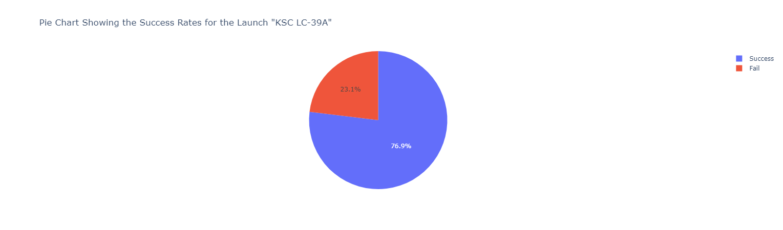
Pie chart for the launch site with highest launch success ratio
KSC LC-39A has the highest success ratio, with success rate of 76.9 % and failure rate of 23.1 %.

Slide 41
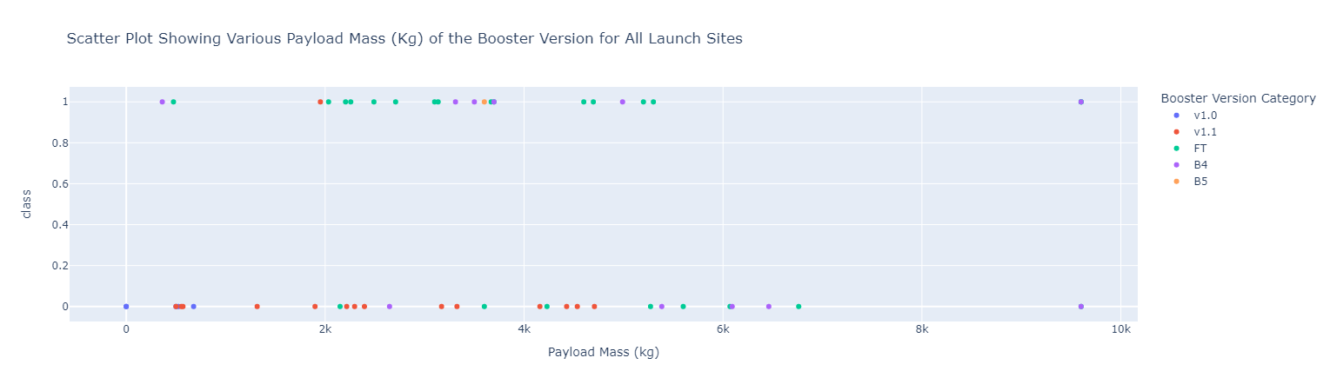
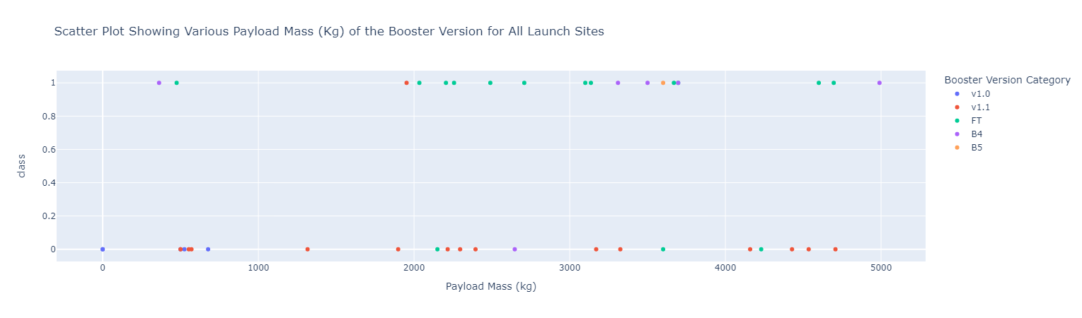
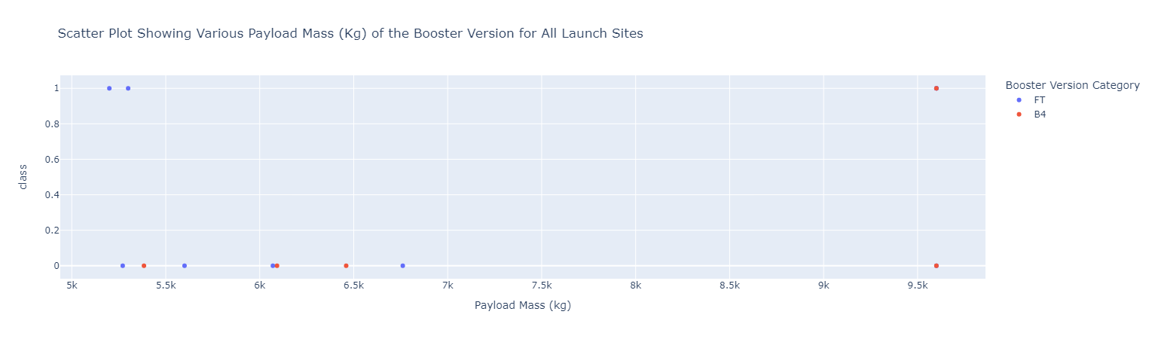
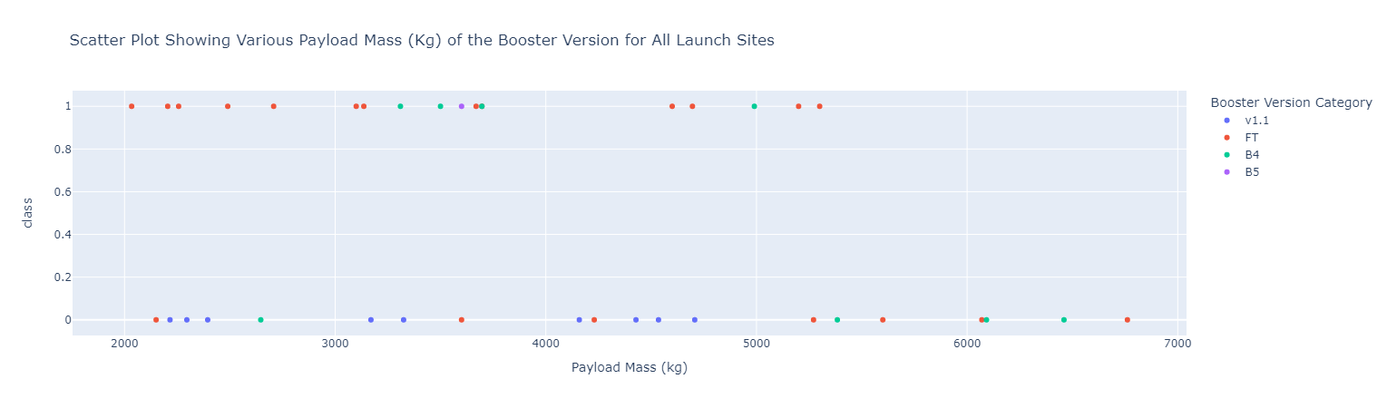
Payload vs. Launch Outcome scatter plot for all sites, with different payload selected in the range slider
From the charts above, it is easy to see that the smaller payload masses had higher success rate than the larger payload masses.
Payload: 0 to 10000
Payload: 0 to 5000
Payload: 5000 to 10000
Payload: 2000 to 8000

Slide 42

Section 5

Slide 43
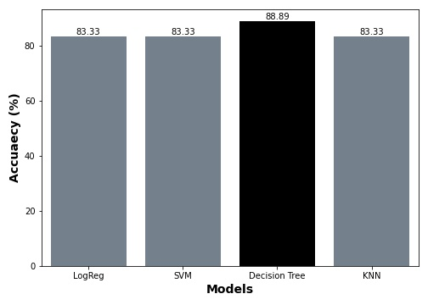
Classification Accuracy
Among the 4 classification models evaluated, decision tree classifier has the highest classification accuracy of 88.89 %.
Others have classification accuracy of 83.33 %.

Slide 44
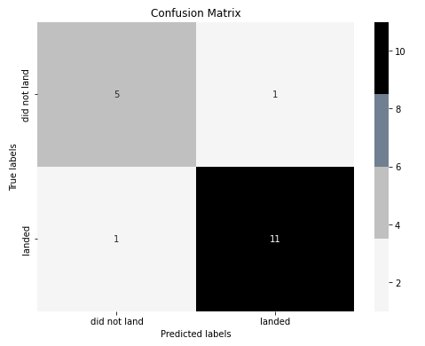
Confusion Matrix of the Best Performing Model (Decision Tree)
TP = 11, FP = 1, TN = 5, FN = 1
Sensitivity = TP/(TP+FN) = 0.92
Specificity = TN/(TN + FP) = 0.83
Precision = TP/(TP +FP) = 0.92
Accuracy = (TP+TN)/(TP+TN+FP+FN) = 0.89
From the metrics above, its easy to see that there is a balance in the ability of the decision tree to classifier to identify both successful landing (high sensitivity) and failed landing (high specificity).

Slide 45
Conclusions
All the models - logistic regression, decision tree, k-nearest neighbor, and support vector machine exhibited high predictive accuracy of greater than 83%. However, decision tree had the highest predictive accuracy of over 88%.
Factors such as launch site, payload mass, and orbit contribute significantly to the successful landing of a Falcon 9 rocket.
The success rates of SpaceX launches increased as years went by as they eventually perfect the art of rocket launching.
Among all the Launch Sites, the landing success rate are higher for lower payload masses. For launch site, KSC LC 39A, the highest failure occurred for payload mass between 4000 and 8000 Kg. Launch Site CCAFS SLC 40 has the highest numbers of launches followed by KSC LC 39A and VAFB SLC 4E.
KSC LC 39A had the most successful launches from all the launch sites.
Rockets with Orbit types of ES-L1, GEO, HEO, and SSO have 100 % landing success rate. Rockets with Orbit type of VLEO have success rate greater than 80 %. Rochets with Orbit types of ISS, LEO, MEO, and PO have landing success rate above 60 %. Rockets with orbit type of GTO have landing success rate greater than 50 %. While, rockets with Orbit type SO have 0 % landing success rate.

Slide 46
Appendix
Link to the cleaned dataset used for the interactive dash-plotly charts: https://github.com/OnahPmi/My_Coursera_Repo/blob/d5b77e783860df1881edfb2928a567734b6549c9/Applied%20Data%20Science%20Capstone%20Project/spacex_launch_dash.csv
Link to the cleaned dataset used for the folium maps: https://cf-courses-data.s3.us.cloud-object-storage.appdomain.cloud/IBM-DS0321EN-SkillsNetwork/datasets/spacex_launch_geo.csv
Link to the one-hot encoded dataset used for building the machine learning models: https://cf-courses-data.s3.us.cloud-object-storage.appdomain.cloud/IBM-DS0321EN-SkillsNetwork/datasets/dataset_part_2.csv
Link to my github repository where all the codes are hosted: https://github.com/OnahPmi/My_Coursera_Repo/tree/main/Applied%20Data%20Science%20Capstone%20Project

Slide 47


